Slide 1
Stock Price Prediction Using LSTM Models
Aidan Pierre-Louis

Slide 2
Problem Description
The project aims to forecast future stock prices using Long Short-Term Memory (LSTM) networks, a type of recurrent neural network (RNN) well-suited for time series data. The goal is to predict future stock daily closing prices based on historical data to theoretically assist in trading decisions.
Tasks performed:
Data preprocessing and feature engineering via a method called ‘lagging’: leveraging temporal relevance of more recent closing prices
Design of model architecture, training, and evaluation
Computed predictions on testing data and developed forecasting strategy to predict future closing prices beyond length of dataset.
Created visualizations to show model performance and prediction accuracy.

Slide 3
Related Work
Traditional time series models such as ARIMA (autoregressive integrated moving average) were used to forecast stock prices but struggle with further predictions due to their inability to capture more complex temporal dependencies.
Machine learning approaches like Random Forests and Gradient Boosting have been used to better effect than more traditional models in forecasting by being able to better leverage these dependencies using ‘technical indicators.’
More recently Deep Learning models such as complicated RNNs (like LSTMs) have shown even more potential in forecasting because of their potential to capture longer-term temporal dependencies in the time series nature of stock price data. Even more recently attention mechanisms used in models (RNNs, Transformers, hybrids) have also shown great potential in this ability too.
Notes:
Technical Indicators are econometrist jargon for numerical patterns that, when considered together, help day traders decipher the complex puzzle of market dynamics.

Slide 4
Data
Source: Historical stock price data, particularly from Yahoo! Finance’s APIs. In this project I used a python library called yfinance that is an unofficial open-source that uses their publicly available APIs. Mostly used Dow Jones companies’ data.
Partitioning: split data 80~95 % into training and testing sets.
Pre-processing: Split into features X and targets Y. X values were arrays of the daily closing prices of day at t and the n_lags number of lagged days prior to t. Y were the price values at that day t.
Normalized data with min-max scaling of -1 to 1 so as to better represent the directional changes of prices than 0 to 1.
Example shape: (1565, 10, 10) for 6 years of price data
Notes:
2191 days in 6 years but market is open 5 days a week so 1565 is the amount of data in 6 years. Second is the length of an individual array for day t with its lagged days. Third dimensional value is a product of the way my code had to be shaped as a sequence object for my first model, working on a new draft to reduce dimensionality of input data.

Slide 5
Example data sample
Date: 2024-08-01
Open: 150.00
High: 155.00
Low: 148.00
Close: 152.00
Volume: 1,000,000

Slide 6
Method
Data preparation: Lagging features and min-max scaling (-1,1) to capture moving averages.
Model Architecture: Network with several layers, multiple LSTM and dense layers, implemented dropout to prevent overfitting.
Training and Evaluation: Adam optimizer, used test set to compute Loss using MSE (mean squared error).
Refer to code examples for more details.

Slide 7
Hyperparameters
Number of lagged days: n_lags = 5, attempted 7, 10, 14
Dropout Probability: p = 0.25, attempted 0.2, 0.5
LSTM Units: hidden_units = 50, attempted 60, 100
Learning rate: lr = 0.001, attempted 0.1, 0.01
Batch size: batch_size = 16, attempted 32
Epochs: epochs = 50, attempted 20, 100
Forecasting Length: forecast_length = 60, attempted 10, 30

Slide 8
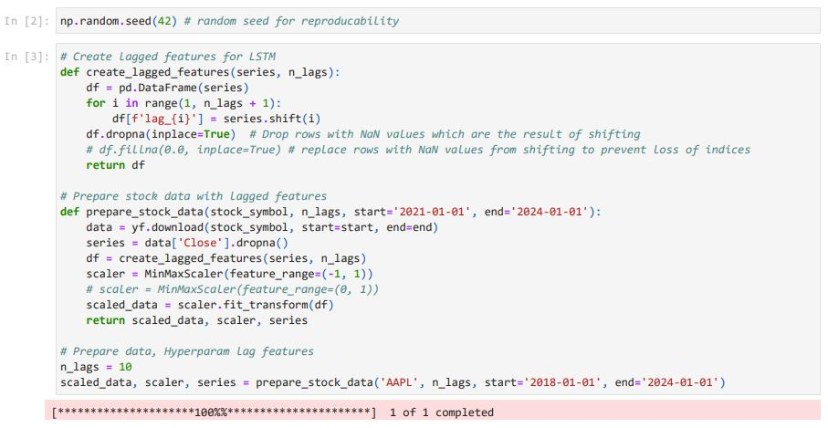
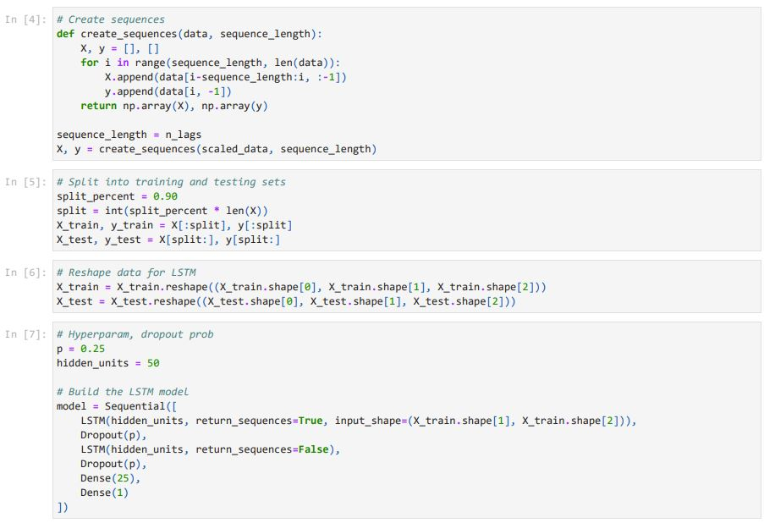
Code snippets 1

Slide 9
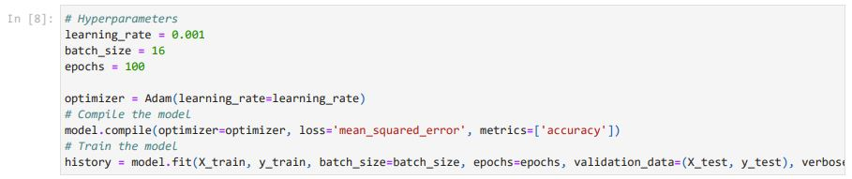
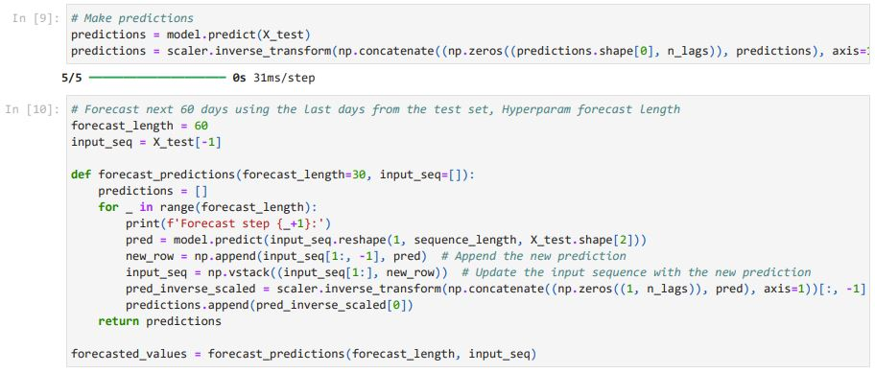
Code snippets 2

Slide 10
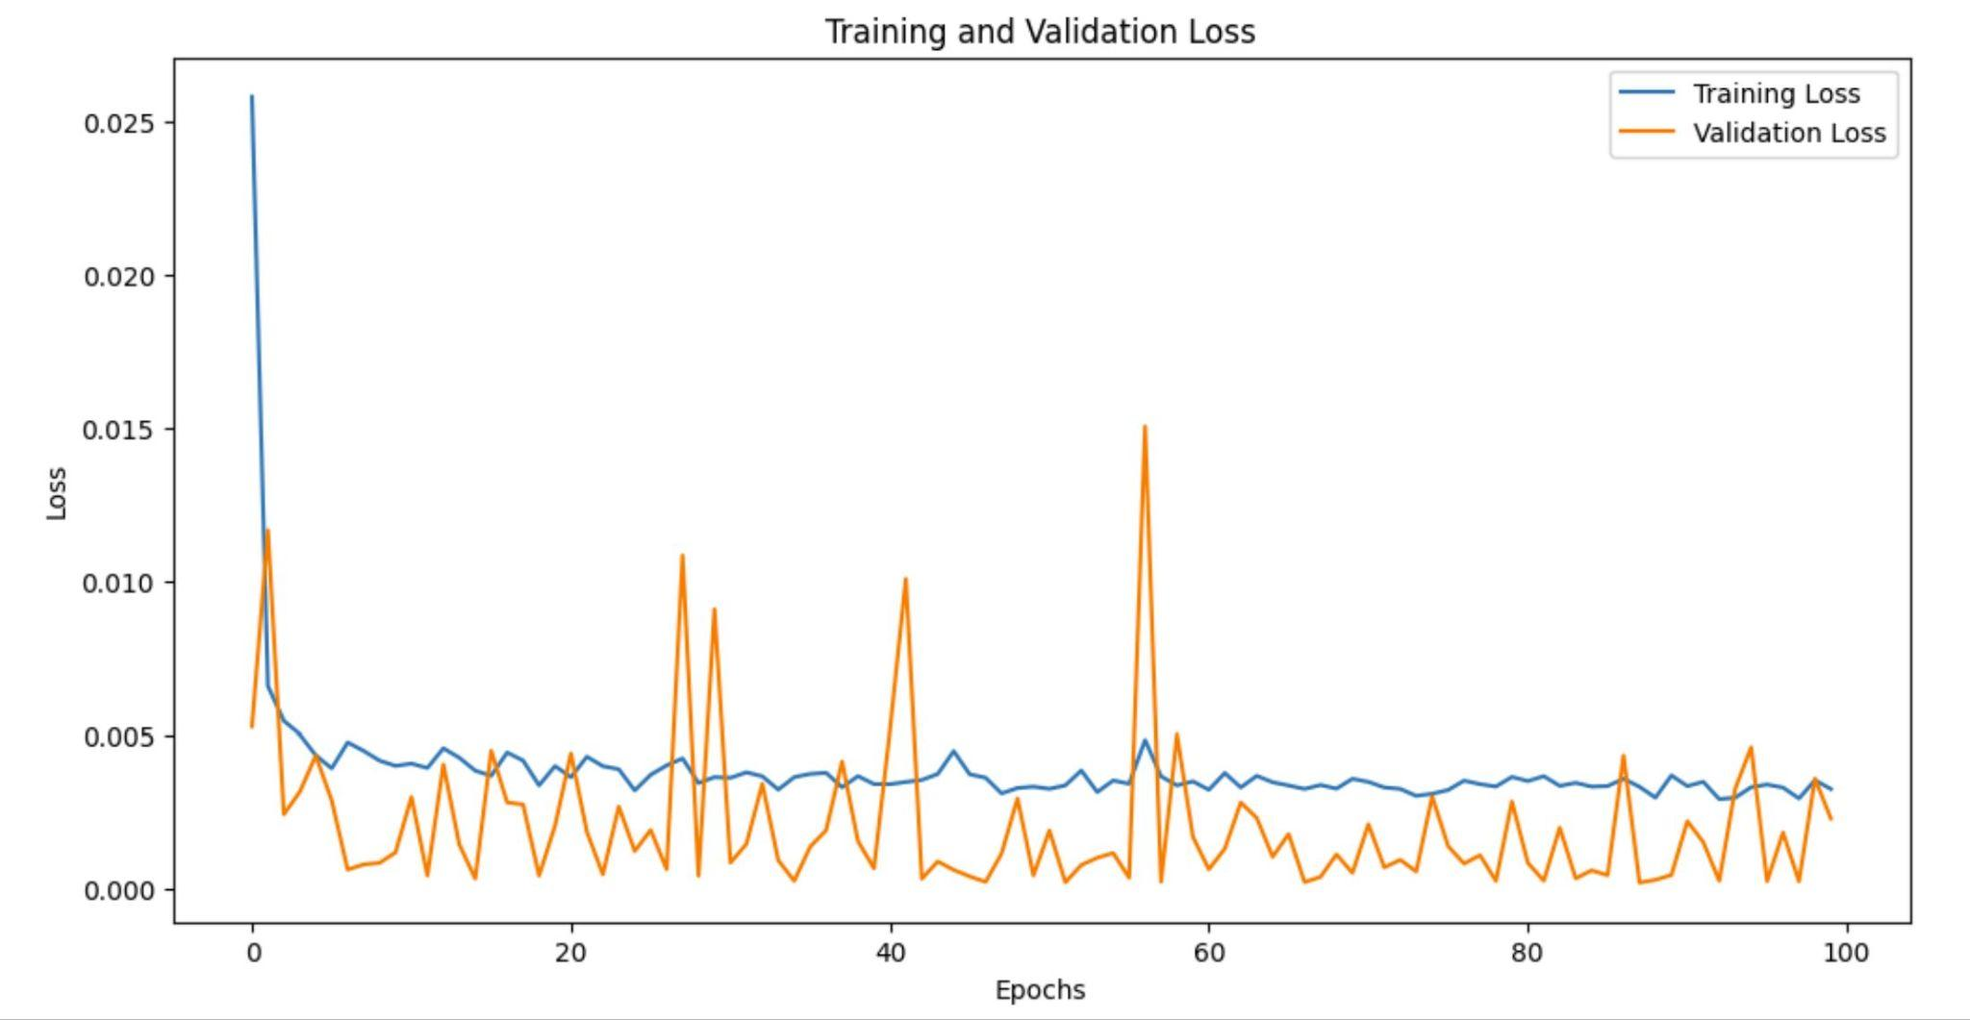
Results - still yet to get meaningful accuracy computations
Notes:
Apologize for the flashbang

Slide 11
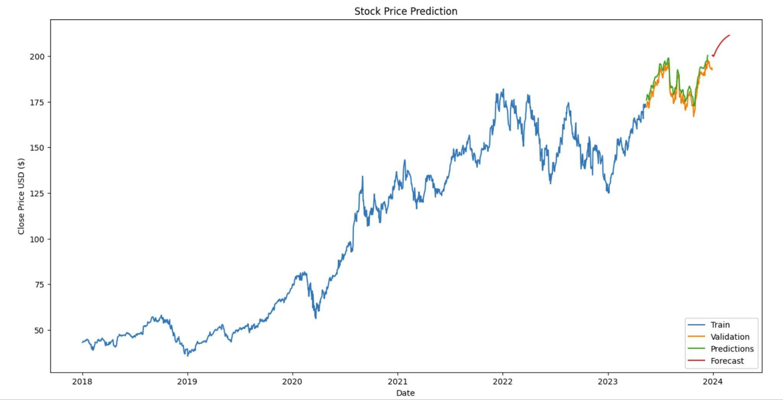
Notes:
This is Apple’s stock price from start='2018-01-01', end='2024-01-01'

Slide 12
